Slide 1
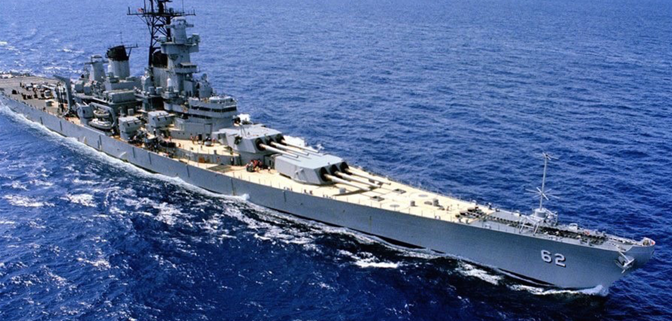
Sink the Fleet
tested by David Landry
designed by Thurman Gillespey, Jason Gautama, Matt Schroder, Jason Duncan, and David Landry

Slide 2
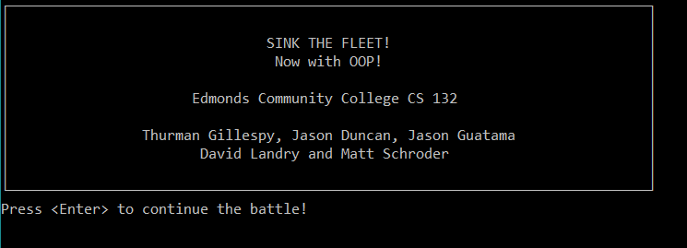
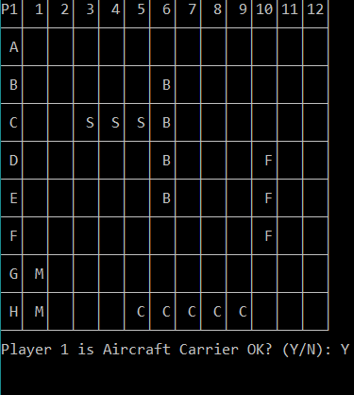
Overview
Sink the Fleet is a Battleship program developed for CS 132, taught by Paul Bladek. It was developed in C++ and is almost entirely composed of objects instantiated from one of 6 different classes.

Slide 3
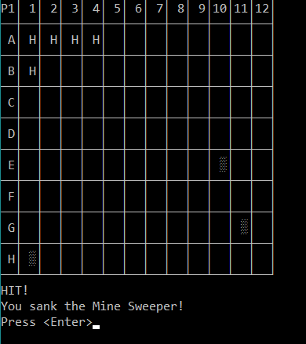
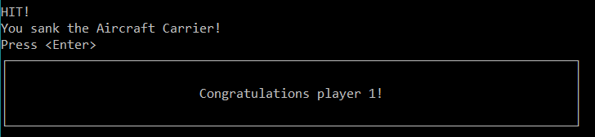
Overview
Main classes focused on:
CPlayer- Workhorse of the project. All about the players and their grids.
CShipInfo- Instantiates a full ship with all info including location & pieces left.
CSinkTheFleet- Class containing the game flow. Buddies with CPlayer.

Slide 4
A Note On Grids/Grid Types and Ship Types
The game is supposed to have 2 grid types:
0 is the ship placement grid, where a player’s ships are located (minesweeper, submarine, frigate, battleship, carrier)
1 is the hit/miss grid
There are 8 “ship” types indicated by numeric ID
0 is No Ship
1-5 is ship type
6 is hit, 7 is miss

Slide 5
Planning Approach
Mostly classical planning
Had a detailed plan going in to it.
Unit tests were mapped out in advance.
Remained adaptive
Some methods were not properly implemented, such as ship piece and player piece decrementers. I had to adjust my plan to handle these.
Testing Script was a list of units and test cases for each.
Exploratory charter developed from decision table and from results of unit testing.

Slide 6
Part 1- Unit Testing Overview
Unit tests were designed and conducted for each method.
184 different test cases over 52 units
Gray box: black box techniques utilizing project code
Mostly equivalence classes & boundary value testing
Control flow testing used to further analyze some bugs.

Slide 7
Part 1- Unit Tests- Equivalence & Boundary
Equivalence class and boundary value testing revealed many flaws at the unit level!
Class constructors do not validate data. Although the main program declares objects with default values, having the added security of validation of values would be beneficial.
CPlayer class had very little validation, allowing input of data in out-of-bounds equivalence classes.
File I/O has no validation checking. Accepts “z:\jfewoi\fjwioj\jflwjel.shp”.
Accessing out-of-bounds columns or grid types led to unhandled exception and CRASH!
Ex: column -1 or grid #2 each caused unhandled exception.

Slide 8
Part 1- Unit Tests- Equivalence & Boundary
Equivalence class and boundary value testing revealed many flaws at the unit level!
CShipInfo class had some domain issues.
Could set a ship to an invalid ship type.
Could set a ship to an invalid number of hits remaining.
For example, I was able to construct a ship of type 8, having -1 hits remaining.

Slide 9
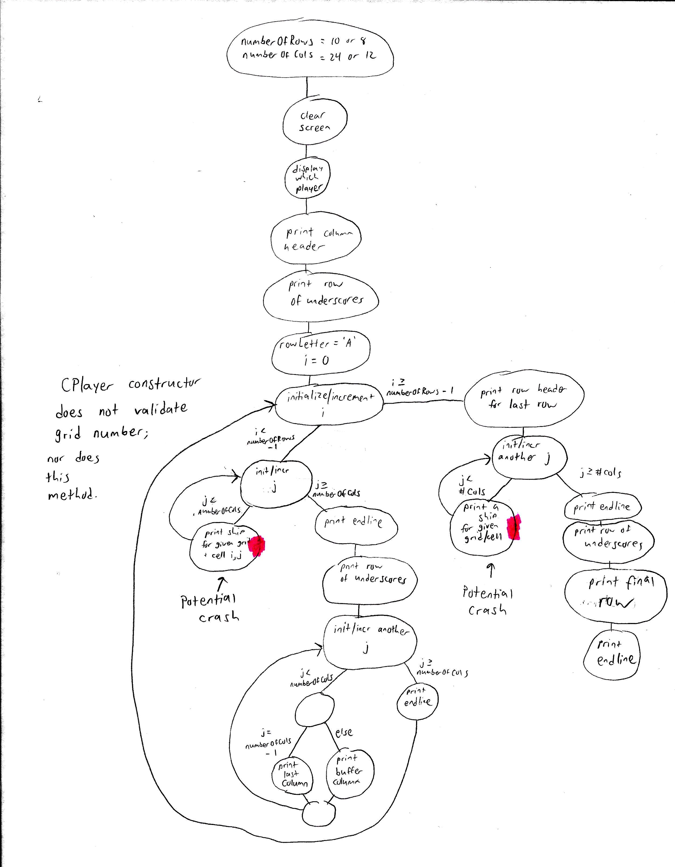
Part 1- Unit Tests- Control Flow
CPlayer’s
printGrid
method
Control Flow testing was able to pinpoint a potential program-killing defect in CPlayer’s printGrid method
The CPlayer constructor does not validate grid type.
CPlayer’s printGrid method also does not validate grid type.
Accessing bad grid type (e.g., grid 2 or grid -1) = no memory allocated = OOPS!!!

Slide 10
Part 2- Integration Testing
Some units, such as those in the CPlayer and CShipInfo classes utilized objects of other classes. Unit testing these, in essence, was a form of integration testing.
Like with the unit testing, equivalence class, boundary value, and control flow testing was primarily used.
Again, the biggest issue is a lack of validation across methods, sometimes leading to program-crashing defects.
When doing control flow testing on the main method and on CSinkTheFleet’s play method, I found how the program “gets around” these critical flaws.

Slide 11
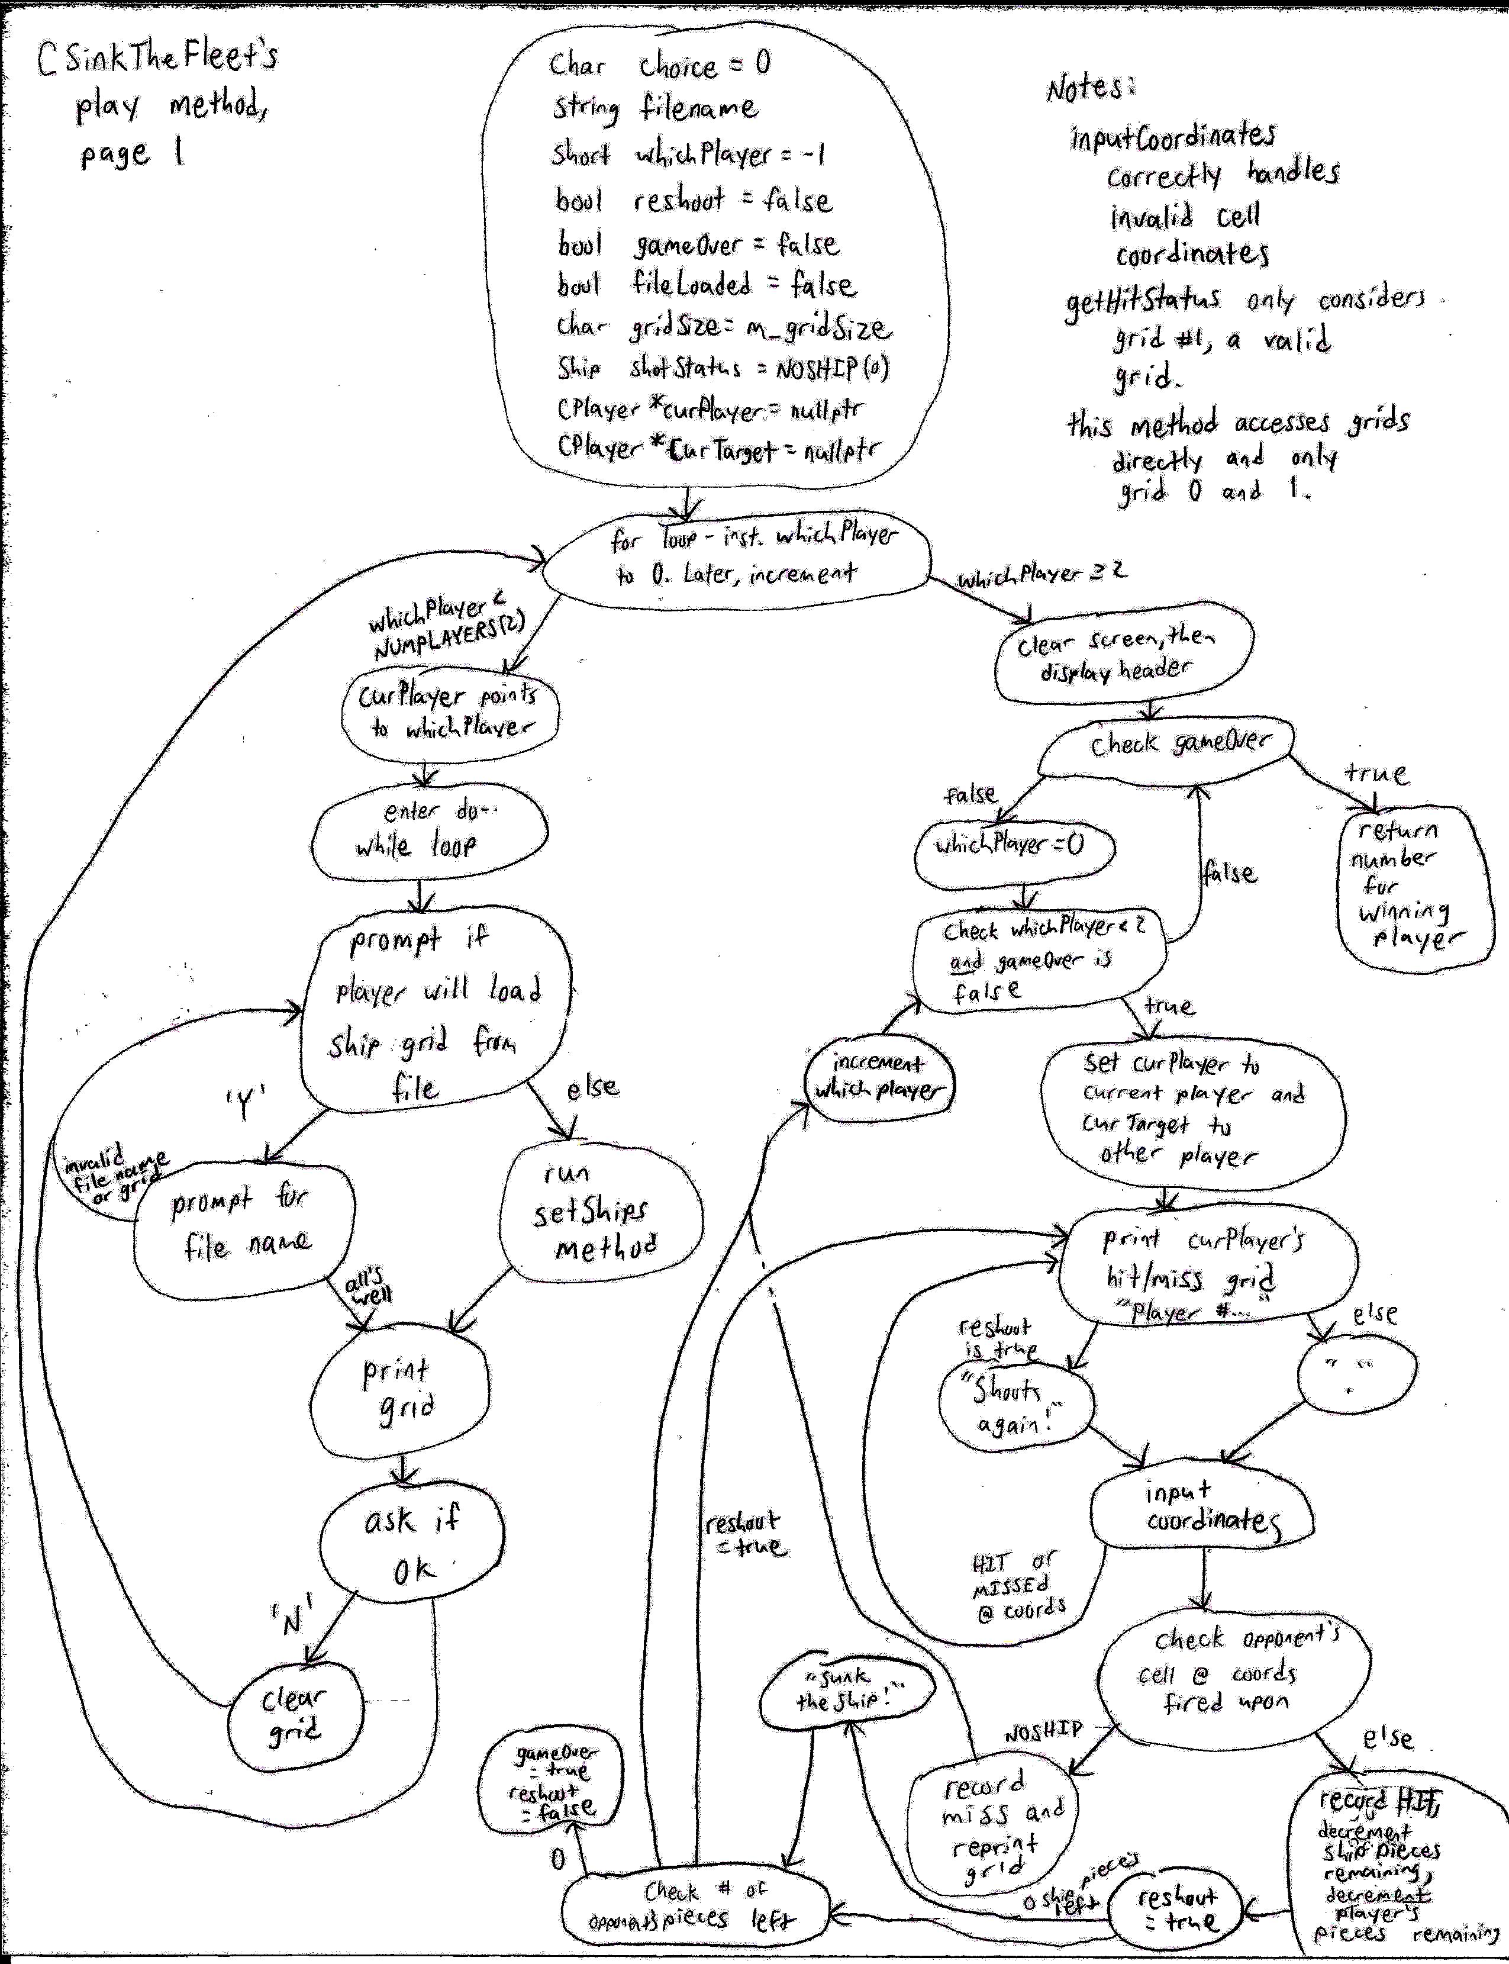

Slide 12
Part 3- System Testing
Main tested
Exploratory testing used primarily
All ranges very well regulated- no weird ships or out-of-bounds placement.
File i/o is a bit wonky- can save to a filename containing illegal characters.
Auxiliary test cases used to help guide testing:
State transition
Use cases
Decision table used to test ship placement

Slide 13
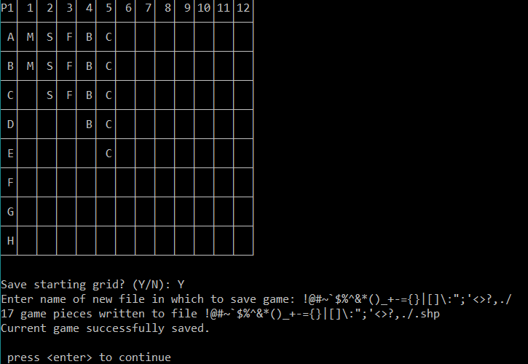
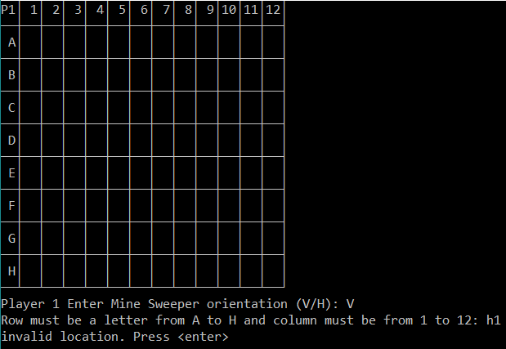
Out-Of-Bounds Caught
I/O Error not caught!

Slide 14
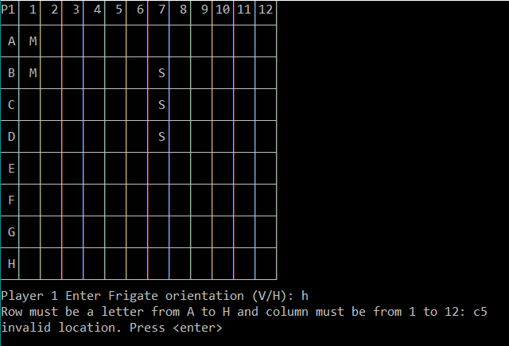
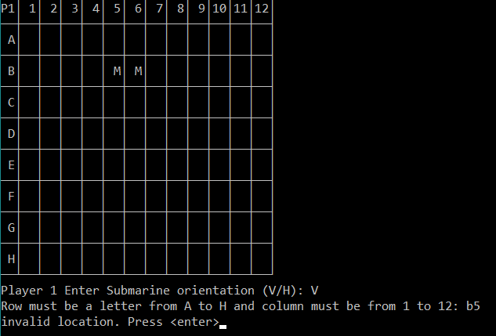
Ship overlap detected.
Bow collision detected.

Slide 15
Part 4- Interesting findings
Lots of bugs at the unit level.
Lack of validation in the constructors
Use of out-of-bounds data
Few bugs at the system level.
Game-crashing bugs worked around in the CSinkTheFleet’s play method.
File i/o an issue.
Almost all bugs were due to issues with equivalence classes.
Game as a whole is flawed, but functional. Workarounds make the game as a whole stable.

Slide 16
Summary- Black Box Testing Techniques
Equivalence Class and Boundary Value Testing
Exploratory testing
Decision table, state transition, and use case
Used to guide testing at the system level.

Slide 17
Black Box Testing Techniques Not Used
Defect taxonomy
Preferred a more exploratory approach.
Domain analysis
All domain issues were adequately addressed with equivalence and boundary value testing.
Pairwise testing
Lack of time, resources, and priority to test the game on different system environments.
Not particularly relevant within the system itself.
Test Script (for scripted testing)
Lack of time to create a formal testing script.
Preferred a more exploratory approach.

Slide 18
Summary- White Box Testing Techniques
Control Flow Testing
Data Flow Testing
Less interesting than control flow
Used in some of CPlayer’s and CSinkTheFleet’s units

Slide 19
When to Stop Testing
My defect discovery rate dropped very quickly at the system (acceptance) level.
Potential buyer might want the file saving issue dealt with before accepting. Might be nice to inform player that there’s an issue with saving a file containing a ? or “double quotes” if the file won’t exist given a name with those characters.
“Ship it!” Deadline was reached, and it was time to complete the project.

Slide 20
Battleship in the background is the Battleship New Jersey. Image courtesy of the Battleship New Jersey Museum and Memorial
www.battleshipnewjersey.org
Testing tools, techniques, and paradigms have been learned from A Practitioner’s Guide to Software Test Design by Lee Copeland and from the excellent wisdom gleaned from CS 290 at Edmonds Community College, Edmonds, WA, taught by Robert Shields.
Sink the Fleet is based on the board game Battleship, produced by Milton Bradley. The project was first assigned by Paul Bladek for CS 132, Computer Science II with C/C++.

